Slide 1
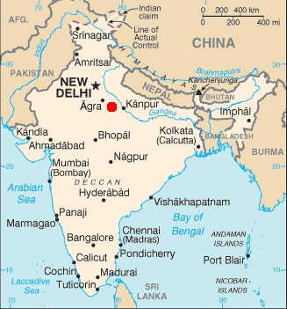
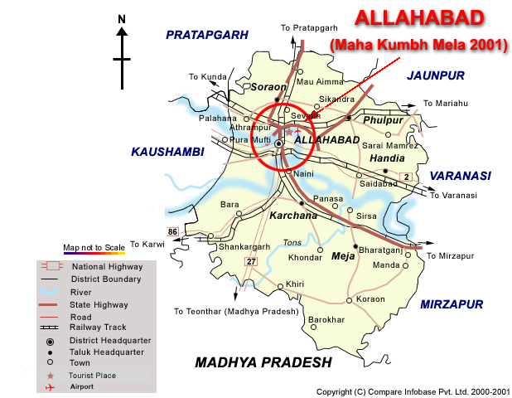
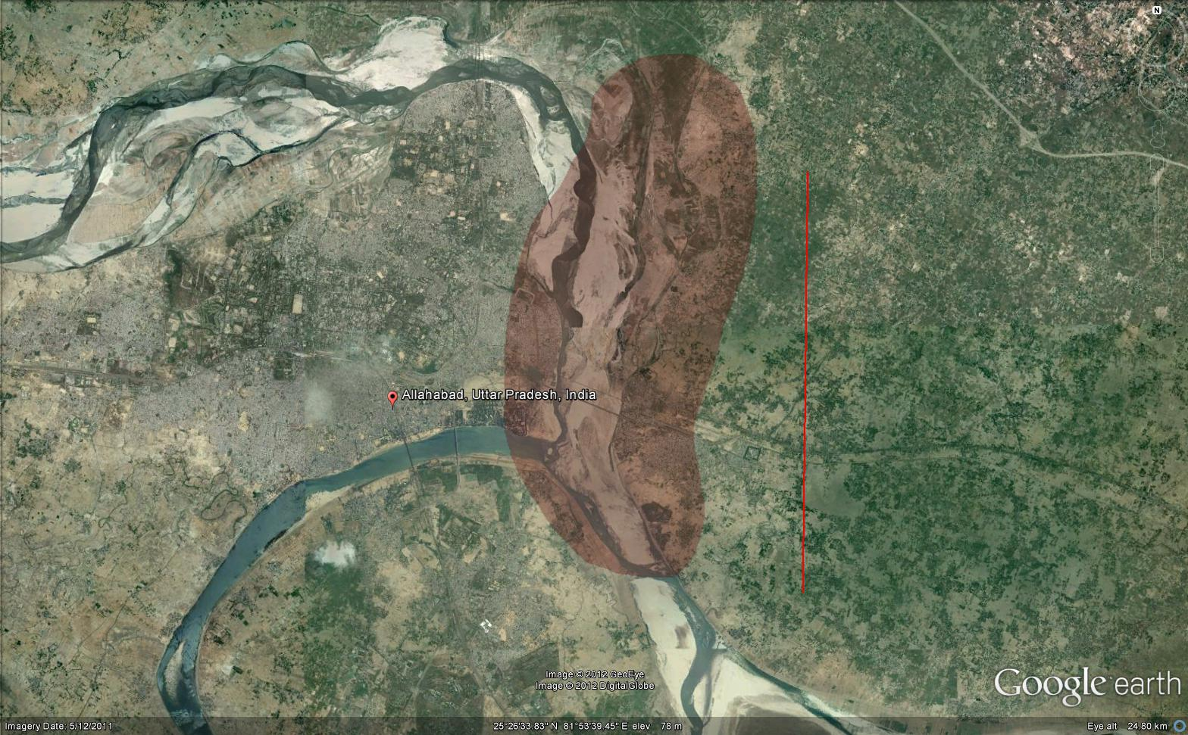
Harvard’s Project: Mapping the Kumbh Mela South Asia Institute at Harvard University
The Kumbh Mela is the largest gathering of people in the world for a Hindu religious fair .
Dates of Maha Kumbh Mela, which occurs every 12 years are: 27 January to 25 February 2013
confluence of the Ganga and Yamuna rivers on the plains of northern India, adjacent to the city of Allahabad.
Location: Allahabad, India
Approx 6000 hectares

Slide 2
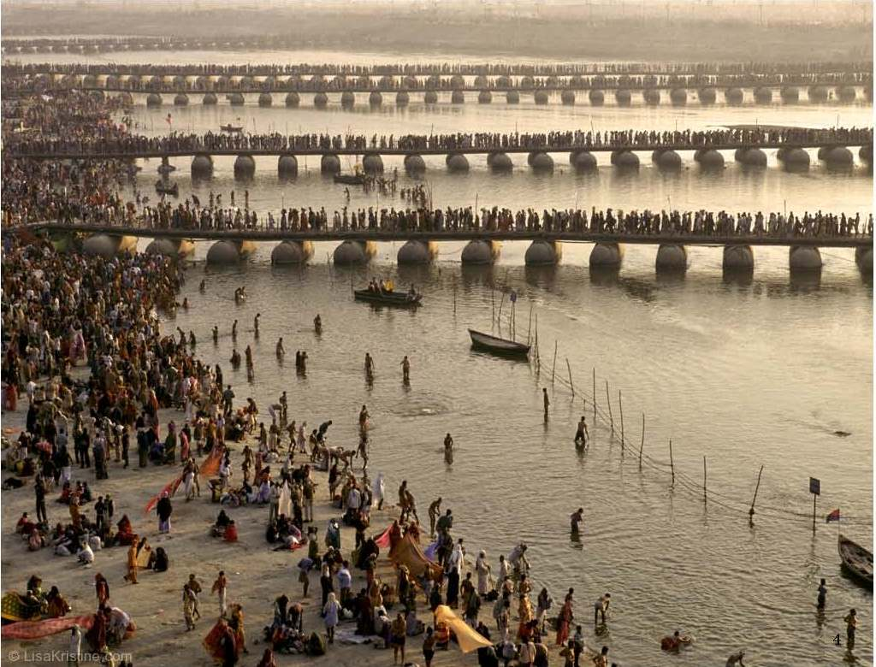
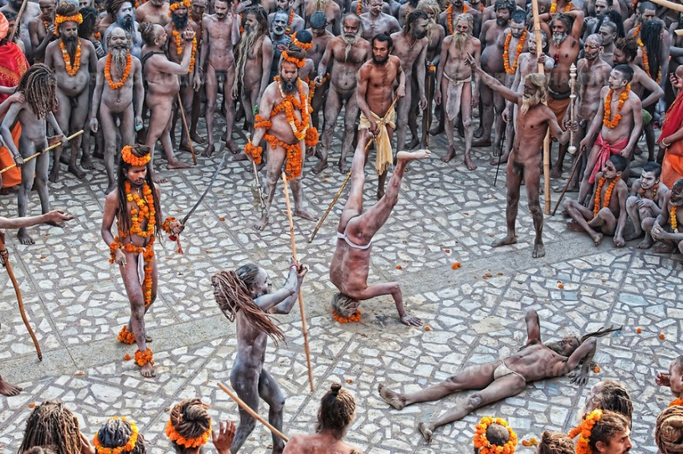
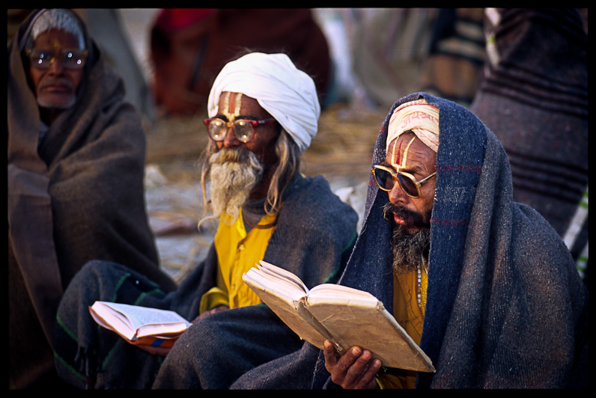
An estimated 30m people will attend the festival over a course of 55 days.
Primary activity of the Kumbh Mela is bathing in the holy waters---said to be especially efficacious at this time and place in eradicating one’s sins
There are also forums for religious lectures and debates, devotional singing, dramatic performances and feeding of holy men and women

Slide 3
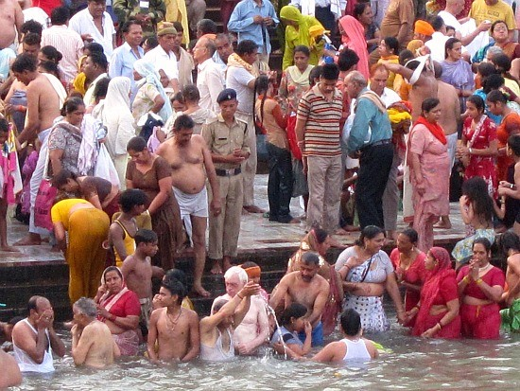
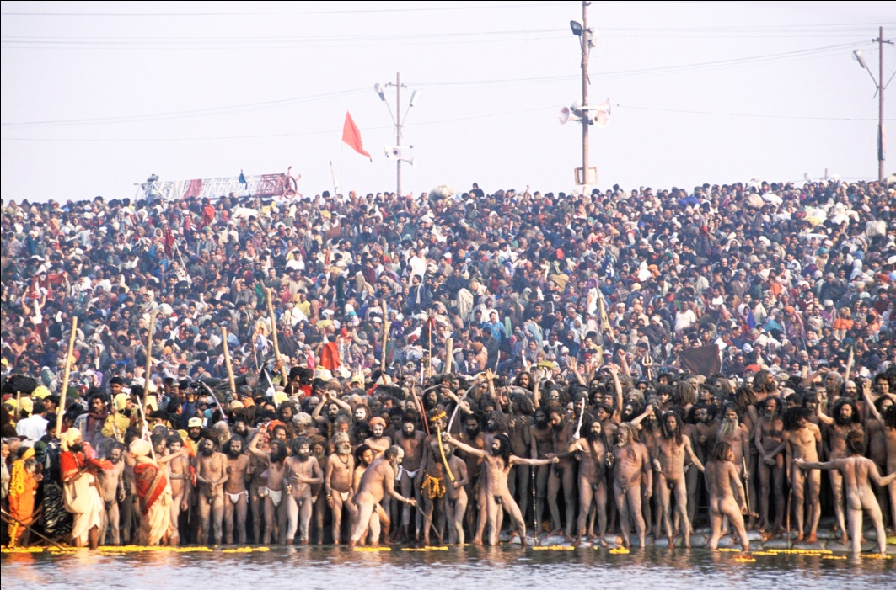
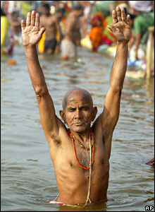
There are around eight major bathing days where the competition for who gets to bathe when and where is quite fierce.

Slide 4
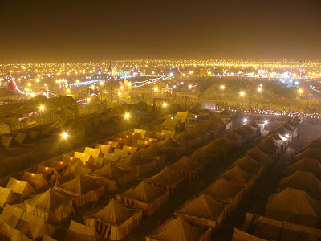
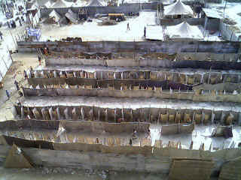
The city is laid out on a grid, constructed and deconstructed within a matter of weeks.
Within the grid, multiple aspects of contemporary urbanism come to fruition:
zoning
electricity grid
food and water distribution
physical infrastructure construction, mass vaccinations,
public gathering spaces,
nighttime social events
Public toilets at the Kumbh site

Slide 5
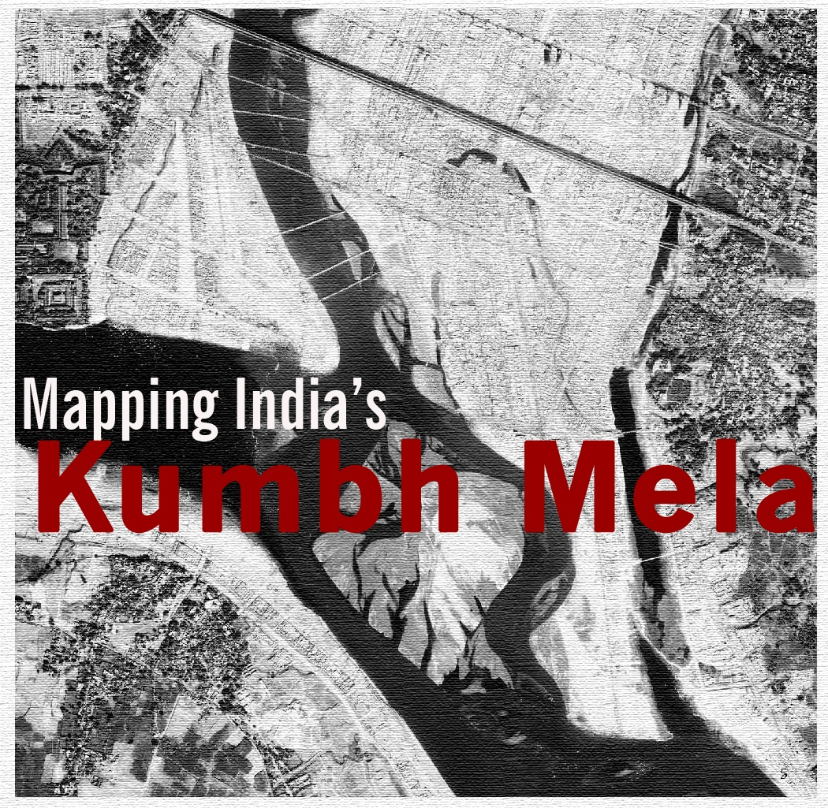
South Asia Institute at Harvard University
Harvard’s Mapping India’s Kumbh Mela Project is comprised of people from various Harvard schools and local institutions: 6 faculty,15 students, and 5 staff.
Diana L. Eck | FAS and HDS
Rahul Mehrotra | GSD
Tarun Khanna | HBS
Sue Goldie | HSPH
Jennifer Leaning | HSPH
Cherry A. Murray | SEAS

Slide 6
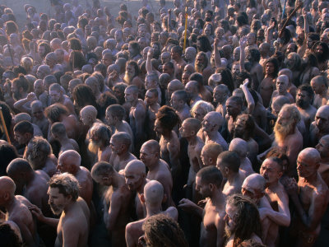
Kumbh Mela: A Case Study
The Mela is a case study, or prototype, for the pop-up mega-city.
It is a manifestation of temporary or flexible urbanism that responds directly to the festival’s needs to provide public utilities for millions of people in a short span of time.

Slide 7
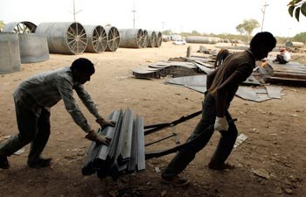
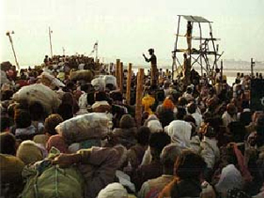
Kumbh Mela: A Case Study
How can this spatial model be extended to situations outside of religious pilgrimage such as:
reconstruction after tsunami or earthquake
distribution of vaccinations and other medical services to the poor

Slide 8
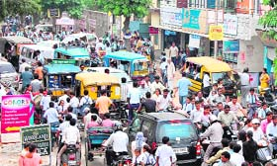
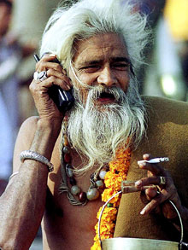
Kumbh Mela: A Case Study
development of sustainable overlaps of urbanism and agriculture elsewhere in the world?
creation of an urban typology for other, more precarious contexts relating to disaster response, public health and sustainability.

